Slide 1

Kegebeya: The Future of B2B Procurement and Delivery
Premium Platform for Marketplace & Logistics

Slide 2
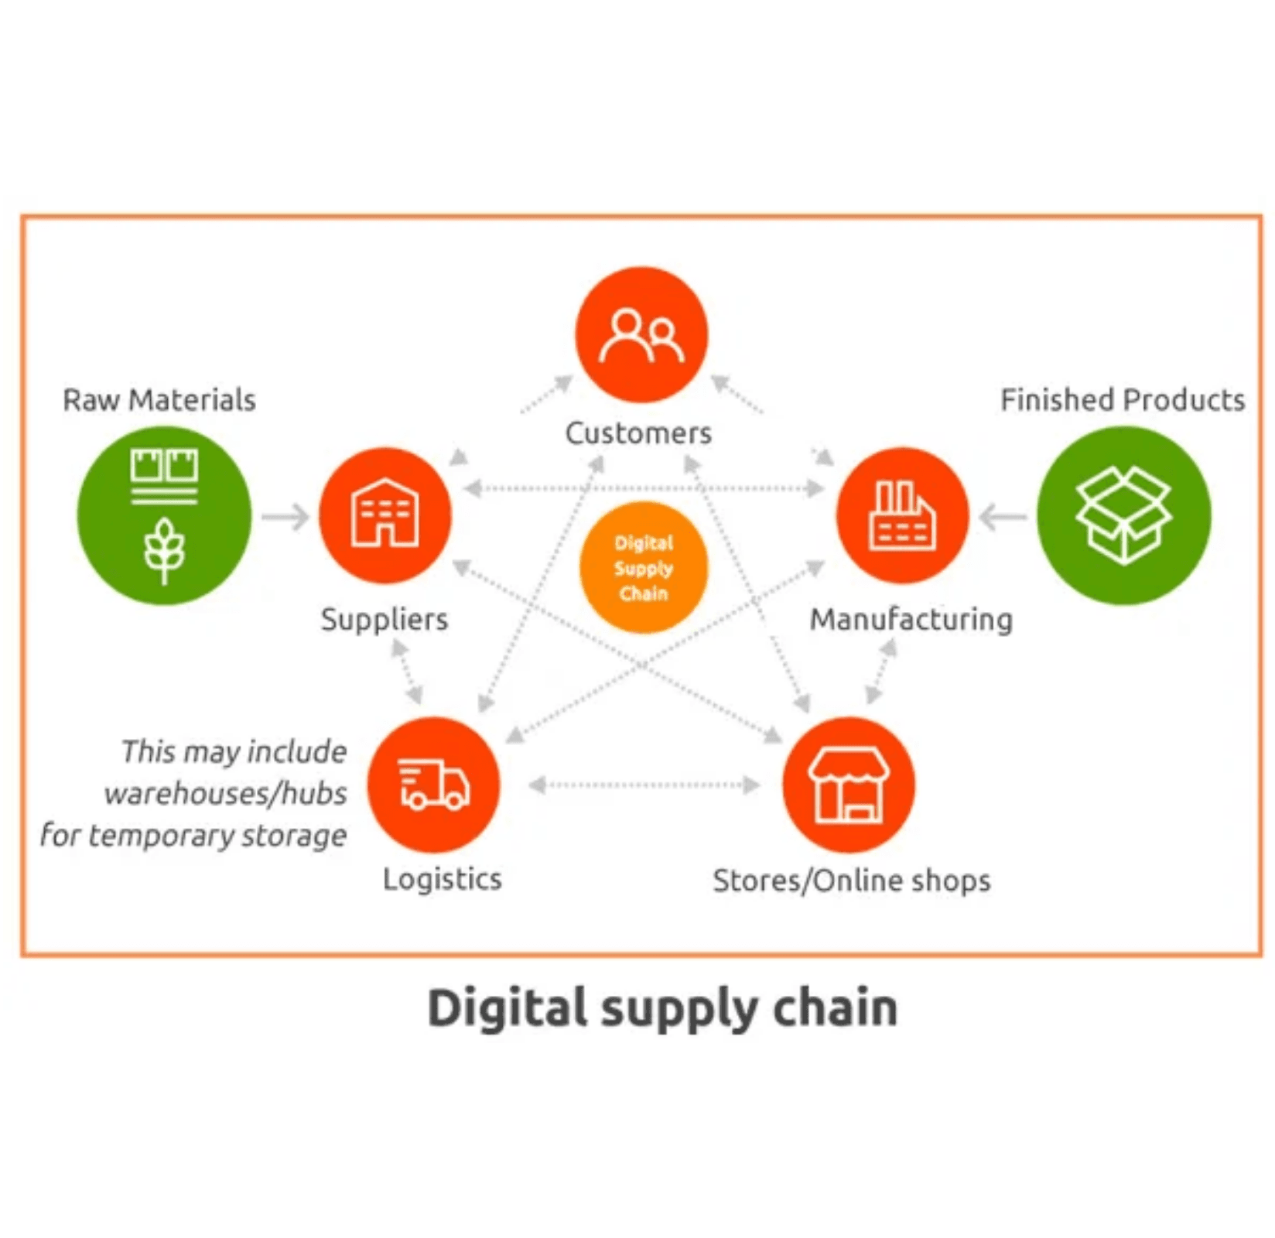




Unifying Commerce: Marketplace and Delivery Synergy
Integrated Solution: A single platform for both sourcing goods (Marketplace) and managing their movement (Delivery).
Marketplace Product: Facilitates seamless procurement through structured RFQs and flexible direct orders.
Delivery Product: Provides end-to-end delivery management for efficient, tracked logistics.
Premium Experience: Designed with a high-contrast palette for trust, clarity, and ease of use.

Slide 3





Structured Sourcing: From RFQ to Order
RFQ-Based Procurement
Supplier Quotations
Streamlined Negotiation
Flexible Ordering
Suppliers respond with detailed quotes, including pricing and guaranteed delivery dates.
Orders can be created directly from accepted quotes or via direct listing purchases.
Buyers create detailed **Request for Quotations (RFQs)** for multiple items and quantities.
Buyers can easily accept or reject quotations, accelerating the selection process.

Slide 4




Comprehensive Order Management and Fulfillment
Full Lifecycle Tracking
Pending
Confirmed
Completed
Cancelled
Flexible Fulfillment Options
Self Pickup
Delivery
Buyer-managed logistics for direct collection from the supplier.
Platform-managed logistics utilizing the integrated Delivery Product.

Slide 5
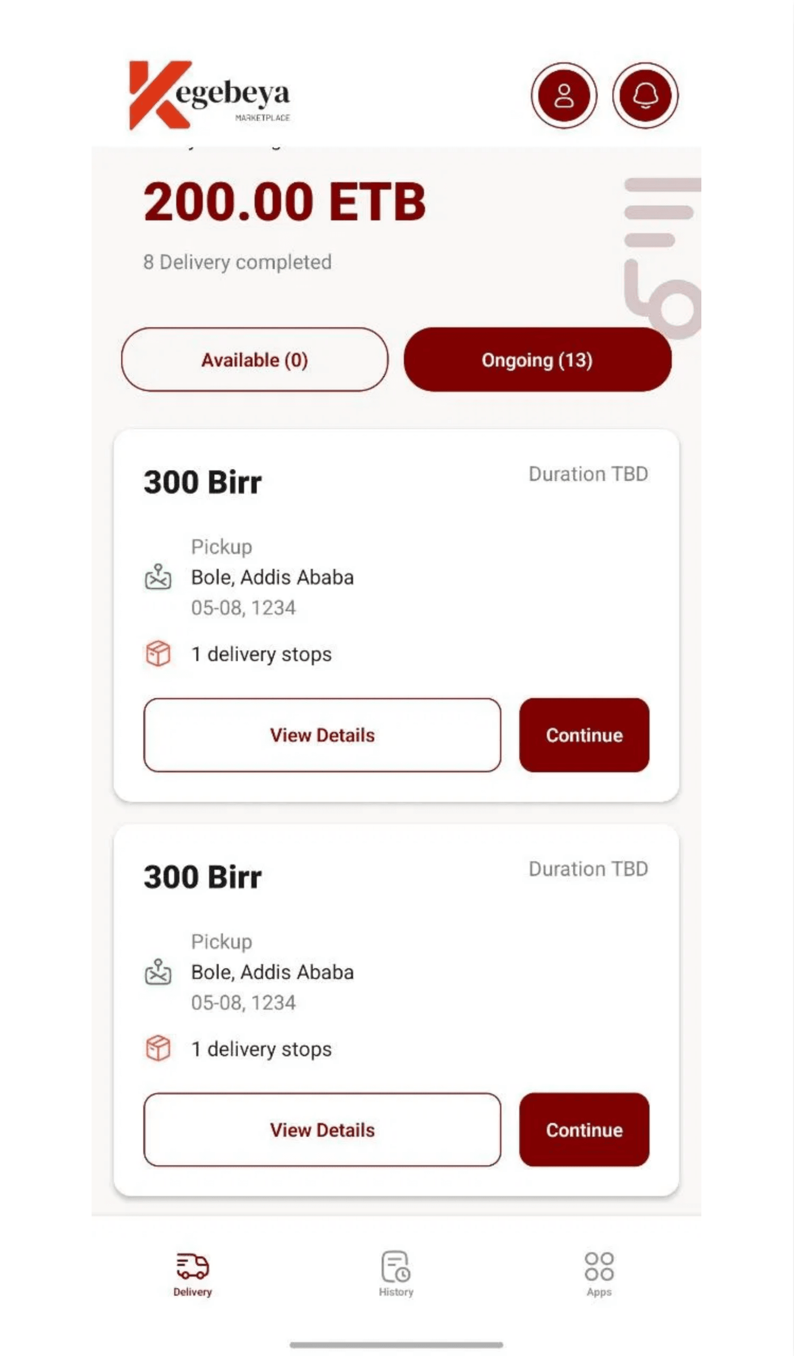



Efficient Logistics: Real-Time Delivery Management
End-to-End Control
Manages the entire delivery process from creation to final handover, ensuring full oversight.
Real-Time Status Tracking
Clear, sequential tracking of delivery orders through a managed lifecycle:
Draft
→
Assigned
→
Picked Up
→
In Transit
→
Delivered
Optimized Assignment
Efficiently assigns drivers based on delivery order requirements, vehicle type, and driver availability.

Slide 6




Optimized Fleet and Driver Assignment
Flexible Driver Assignment: System posts delivery orders to the platform which are picked up by the most suitable driver and vehicle.
Diverse Vehicle Support: Supports a full range of logistics needs, including **Motorcycles, Cars, Vans, and Trucks**.
Detailed Profiles: Maintains detailed profiles for both drivers and vehicles for compliance and performance tracking.

Slide 7
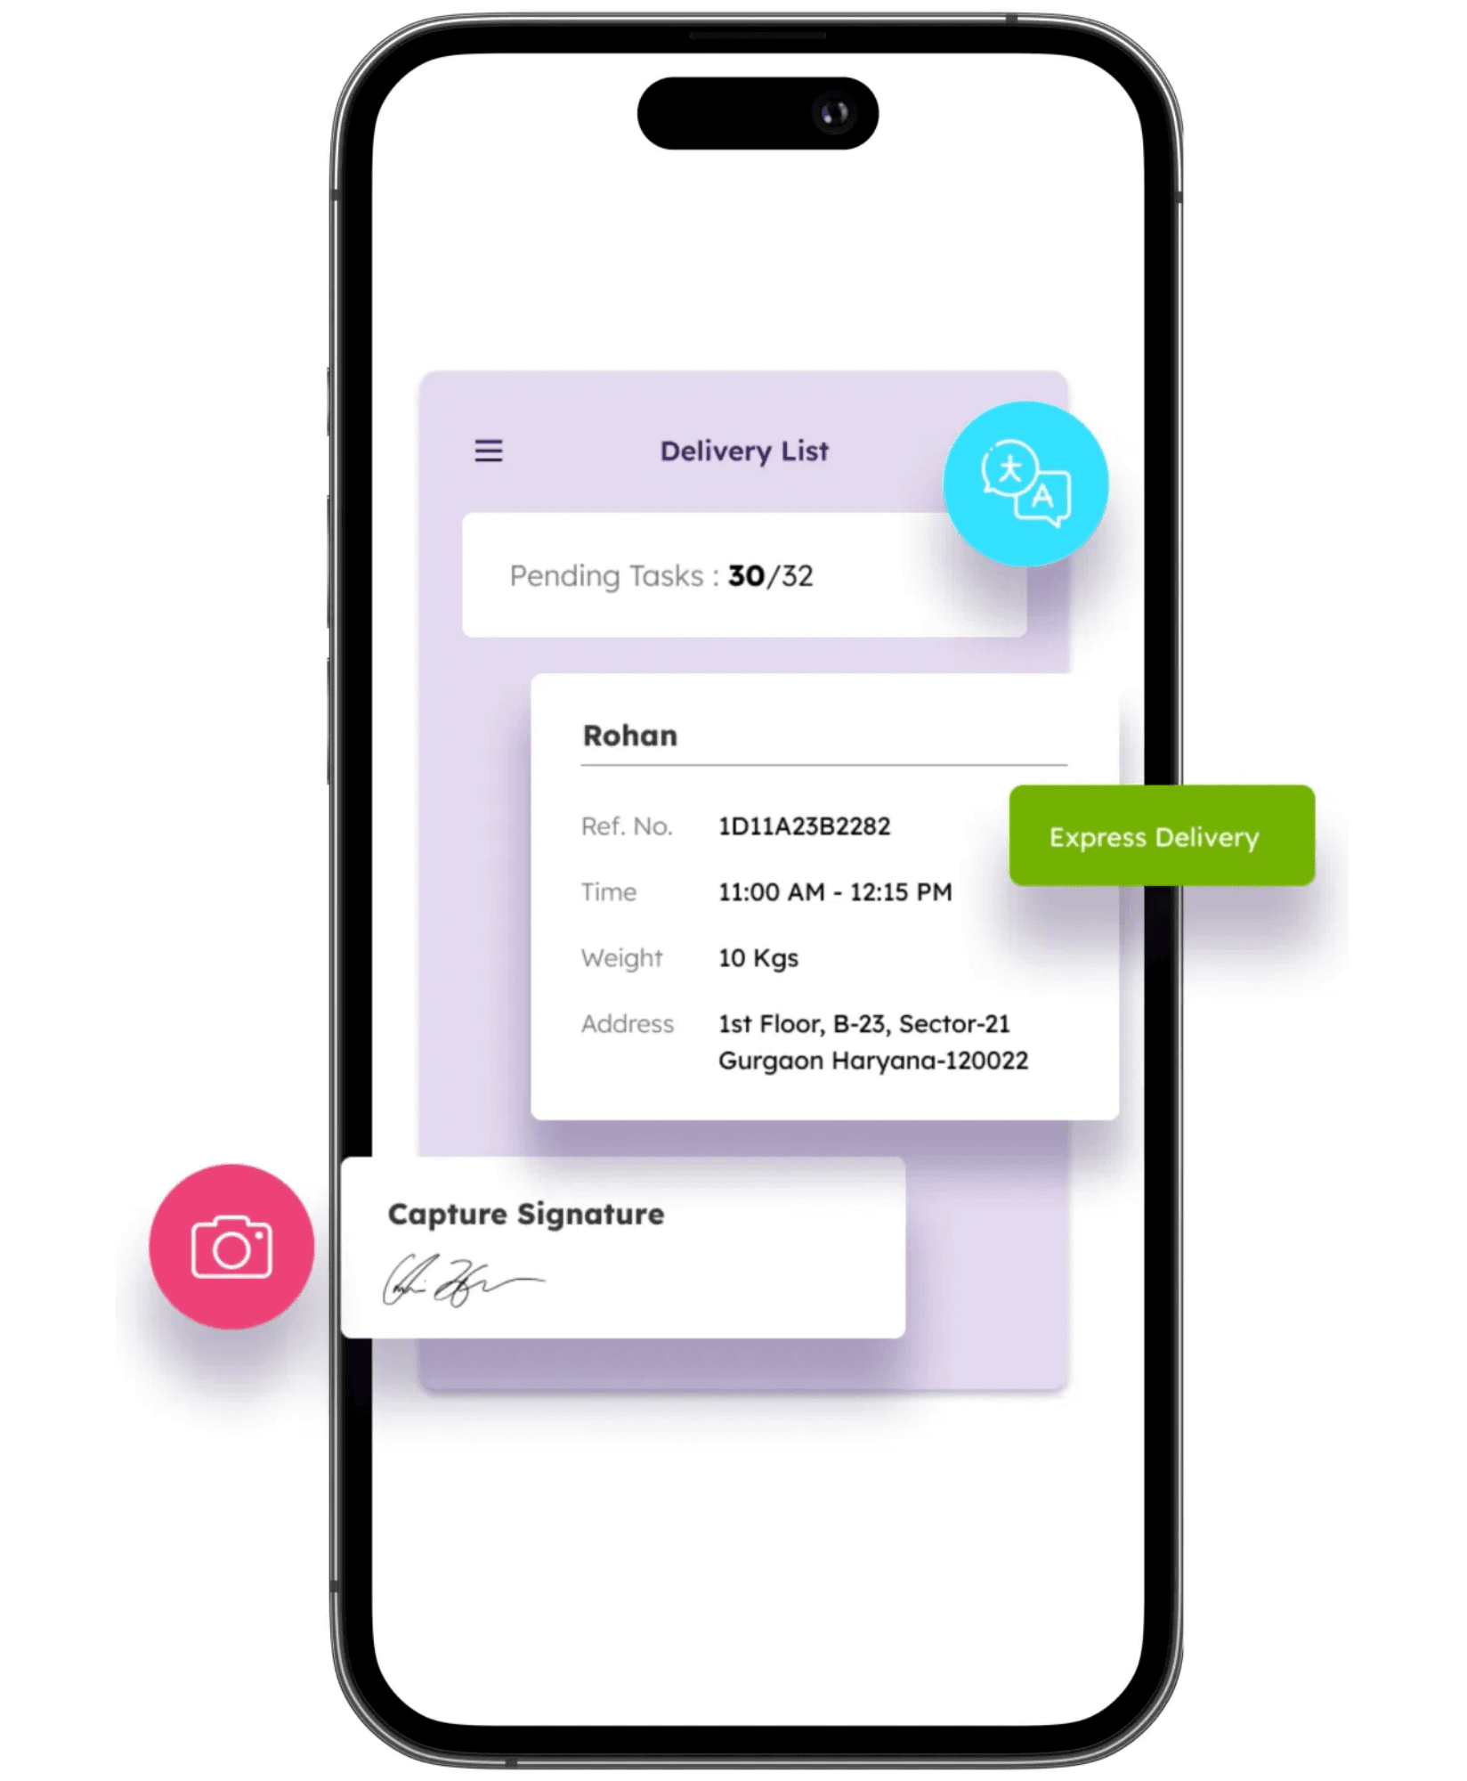



Secure Handover and Dispute Resolution
Secure Receiver Confirmation: Requires a secure confirmation from the receiver upon successful delivery (Proof of Delivery).
Immediate Issue Reporting: Built-in workflows allow receivers to report issues like (damaged, missing, or wrong items) instantly.
Dispute Mechanism: A clear process for receivers to dispute deliveries if specifications are not met, ensuring accountability.

Slide 8




Kegebeya: Driving Efficiency in B2B Commerce
End-to-End Control: Complete management of both procurement and logistics from a single platform.
Trust and Transparency: Clear tracking, secure confirmation, and robust dispute resolution.
Scalable Logistics: Optimized fleet management to support business growth and diverse needs.
Investment Opportunity: Redefining the B2B marketplace and delivery landscape.

